Slide 1




INTERNET & HIGHER LAYER PROTOCOLS
By Dr. Moshiur Rahman
PRIVATE KEY
ENCRYPTION
Using Symmetry Algorithm
Sathvika Karri (sk3628)
Rohan Katkam (rk944)

Slide 2
OBJECTIVES
1
The objective of the project is to implement symmetric encryption using the Advanced Encryption Standard (AES).
2
Securely encrypt and decrypt data.
3
Ensure confidentiality and integrity of communication.

Slide 3
ALGORITHM USED
We used the Advanced Encryption Standard (AES) algorithm for symmetric encryption. AES is renowned for its robust security and efficiency, making it an ideal choice for encrypting sensitive data in the code.
Key Features:
AES withstands various cryptographic attacks due to its substitution-permutation network (SPN) structure.
AES offers fast encryption and decryption processes, suitable for both hardware and software platforms.

Slide 4

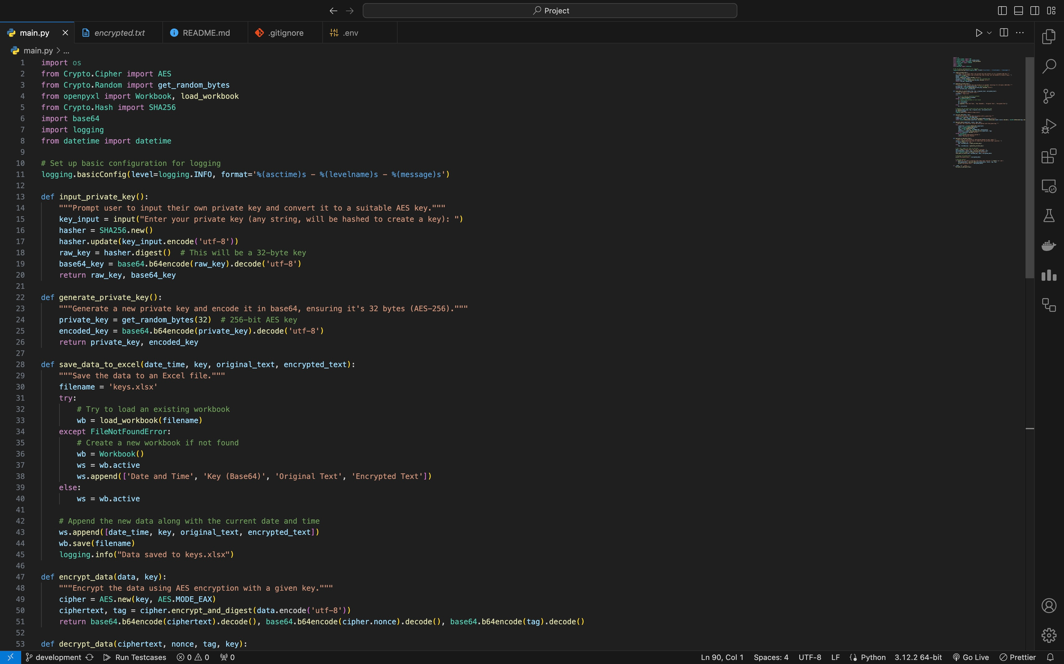
Code Snippet

Slide 5
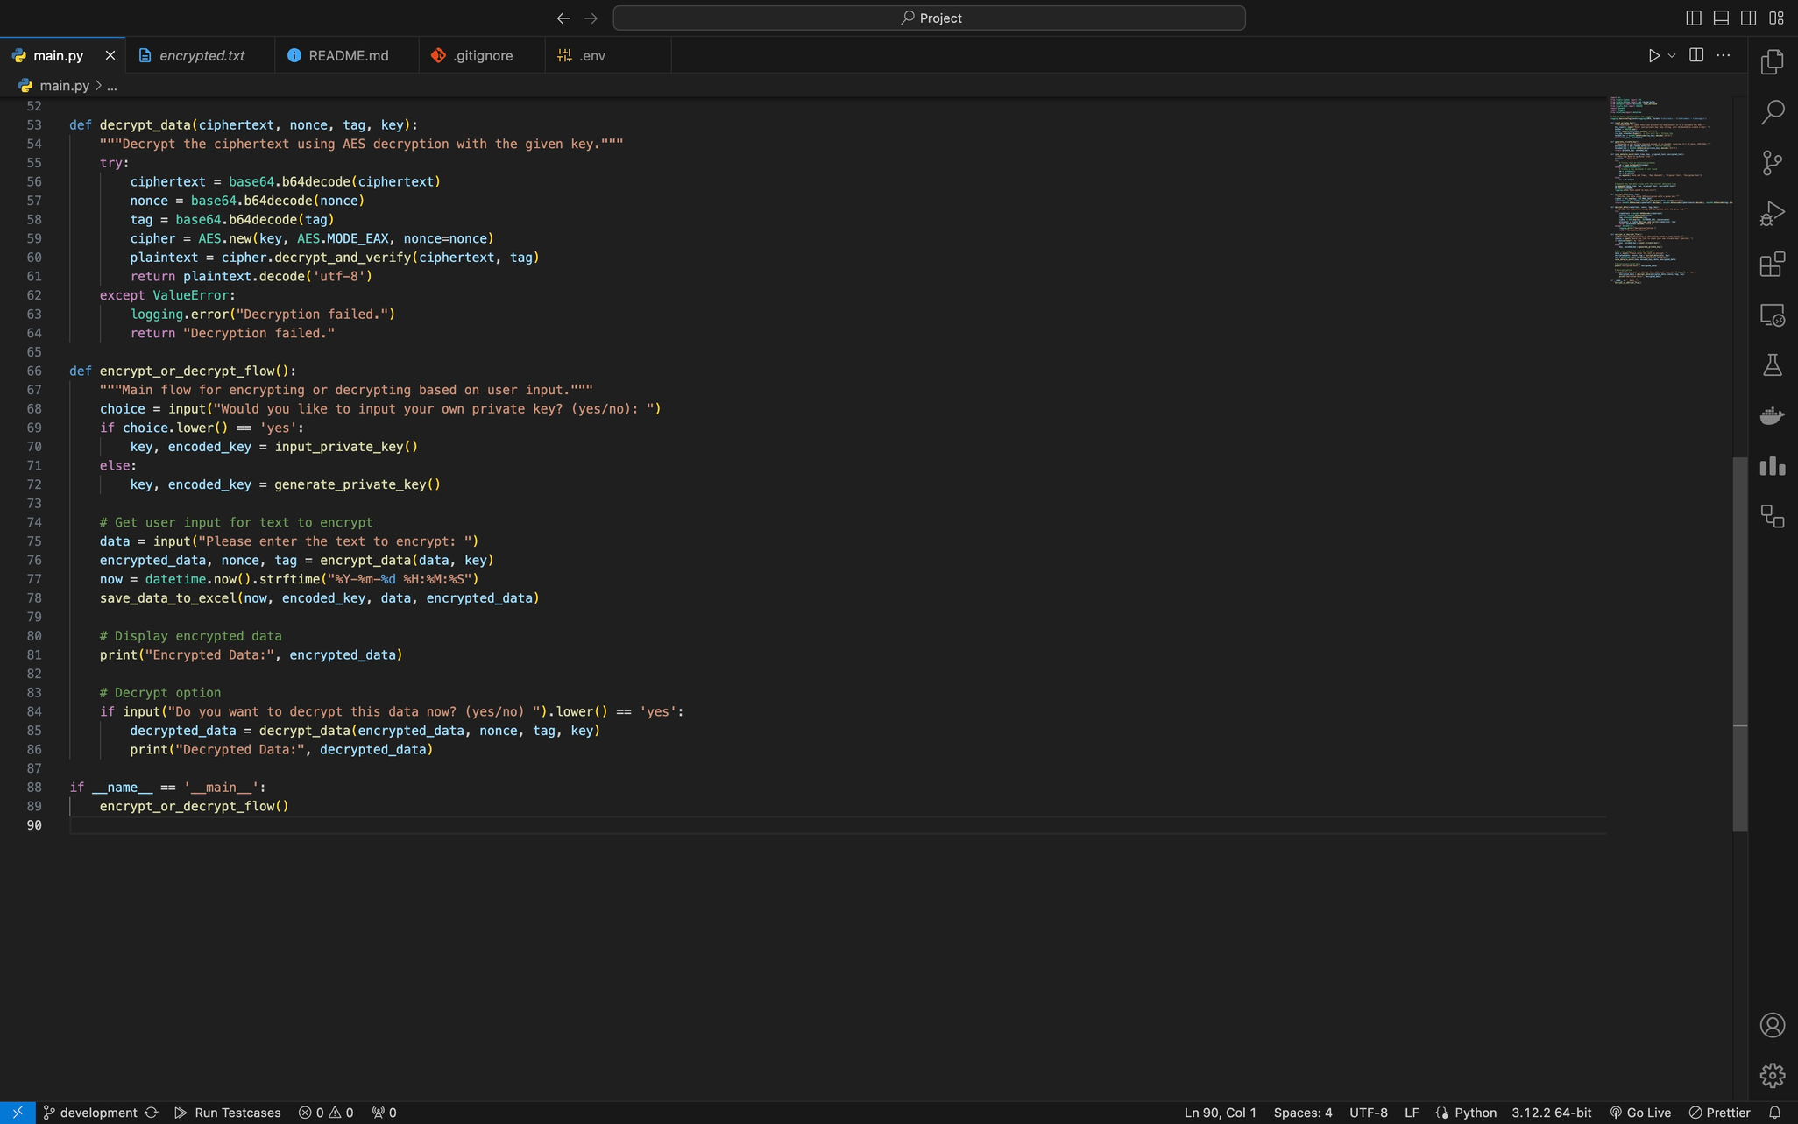

Slide 6
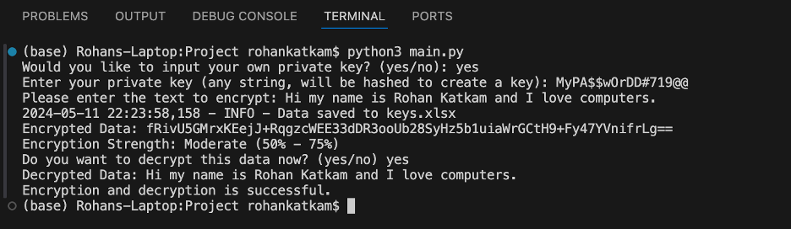
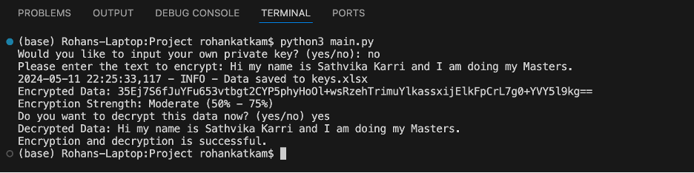
Output with creating a new private key
Output with default private key

Slide 7
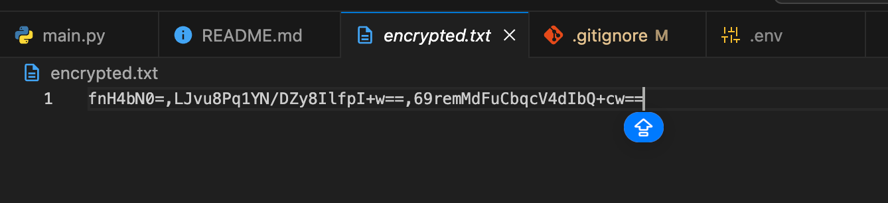
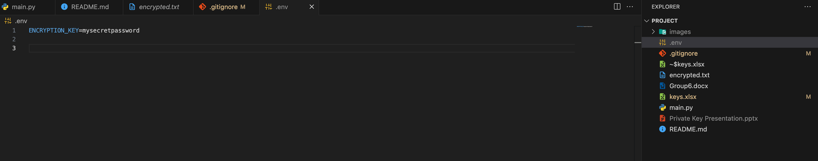
ENCRYPTION.TXT
DEFAULT PRIVATE KEY

Slide 8
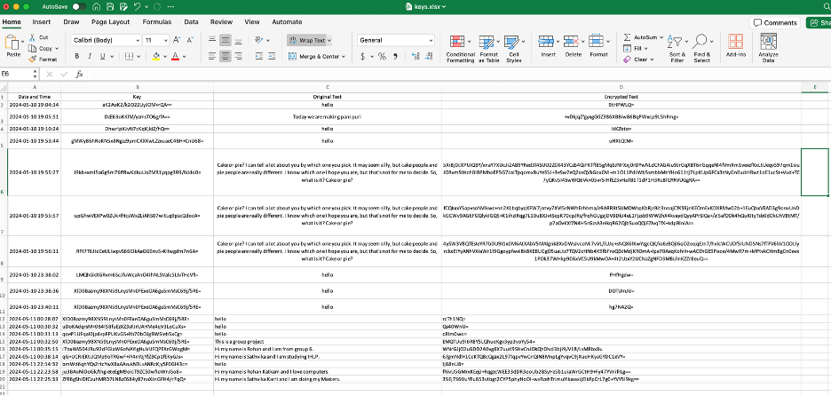
KEYS.XLSX

Slide 9

Difficulties faced
One of the main difficulties was to understand the AES algorithm.
Figuring out the correct timing for applying Base64 encoding was initially confusing, leading to several trials to ensure proper encoding and decoding during encryption and decryption.
Integrating SHA-256 for user-provided keys to ensure security for AES encryption required a deep understanding of cryptographic standards.
Implementing encryption and decryption functions.
Managing encryption keys securely.

Slide 10
FUTHER DEVELOPMENTS
We want to use this algorithm for better and more secure implementation for huge data.
Better enhance the key management functionalities
Implementation of multiple private key generations which can be more safe and unique for more security.

Slide 11
CONCLUSION
Effective Encryption: The project implemented AES-256 encryption, utilizing SHA-256 hashing and Base64 encoding to ensure all keys met security standards, providing a reliable and secure data encryption and decryption method.
Improved Functionality: Detailed logging in Excel and text formats improved the tool’s traceability and user guidance, making it an informative resource for practical encryption applications.

Slide 12
THANK YOU

